Slide 1
ENG 102
Composition and communication skill
Section : 22
Instructor : dr. Akm Zakaria

Slide 2

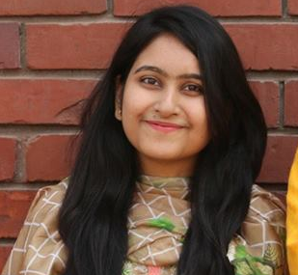
Presented By
Md. Jannatul Haq Nayeem
2018-1-60-224
Jubaida Khanom
2018-3-40-048

Slide 3
Software Development

Slide 4
What is Software
Computer software or simply software is a collection of data or computer instructions that tell the computer how to work.

Slide 5
Data collection
Survey
Through Internet.
By Google Link, Linked In, Facebook.
East West University and many other university inside Dhaka.
Students who reads in class 11-12

Slide 6
Instrument for Data Collection
Microsoft Word.
Google Drive.
Microsoft Excel.
Many social app.

Slide 7
Data Analysis
Software security
Users friendly.
Money recuired.

Slide 8
Discussion and Conclusion
The aim of the survey was to determine the level of awareness about software among the students of East West University and some of the university inside of Dhaka.
We hope our effort and endeavor will achieve your satisfaction. If you need any further clarification, please let us know, we will always be available.
Thank you Sir, and thank you everyone.

Slide 9
Thank You

